Slide 1

Section 8 – Strategy
Online Course Layout:
Section 1 -Familiarity with R
Section 2 – Data Wrangling
Section 3 – Data Visualization
Section 4 – R Markdown
Section 5 – Exploratory Data Analysis
Section 6 – Introduction to Regression
Definition
The regression line
The formula
Auto Example of regression
Progresso soup exercise
Section 7 – Introduction to Machine Learning
Titanic Kaggle Competition
Section 8 – Strategy
Big box store competitors
https://stat.ethz.ch/R-manual/R-devel/library/base/html/Memory-limits.html
Notes:
More on the nuts and bolts or under the hood of the R engine here.
R stores all objects in memory
It can process 8TB of RAM on 64bit operating systems
Rules of the Road for Big Data and R
R can process up to 1 million records with ease
For greater than 1 million and less than 1 billion records, R may struggle to process the data
If you’ve got greater than 1 billion records, its best to use big data platforms that leverage map reduce and processed on big data platforms like Hadoop
Memory Limits in R
https://stat.ethz.ch/R-manual/R-devel/library/base/html/Memory-limits.html

Slide 2
Tweak, tweak and more tweaks
There are endless amounts of tweaking, feature engineering and additional predictive models to choose from
However, higher accuracy comes at a cost
More creativity to generate additional features
Additional resources on CPU’s, Memory, disk space, etc on the machine to generate a model with results
The steps described today are a start and foundation to oil your machine learning capabilities

Slide 3
Strategy

Slide 4
The essence of an organization is its ability to make decisions based on its resources and its ability to improve performance

Slide 5
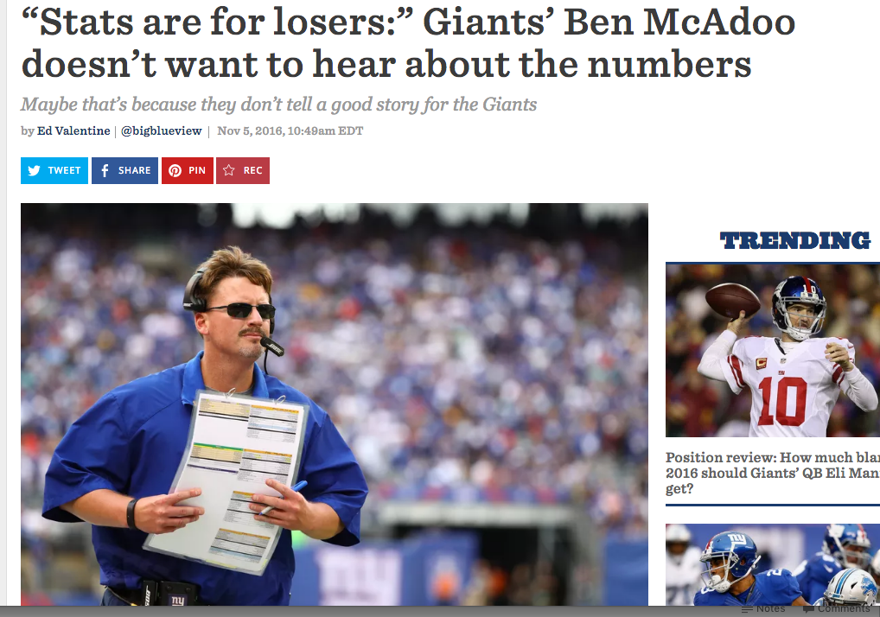

Slide 6
Data Driven Decision Making
Gut Feeling + Factual Data
----------------------------------------
*A Data Driven Decision
*There will always be a human factor

Slide 7
What do Data Science Strategists do?
Use data to analytically address key questions for senior managers
Data?
Can be qualitative or quantitative
5 stars review – qualitative
44% churn rate – quantitative

Slide 8
Current pitfalls in the finance world of strategy for data science
Quarterly Statements
Forced and regulated balance sheets
Hidden loop holes to publicize gains or losses
Not comparable
Sector
Competitors
No real signal
Firms and managers are generally satisfied with the status quo
If it ain’t broke, don’t fix it

Slide 9
…a thing of great power or size, in particular a movie, book, or other product that is a great commercial success.
Notes:
In 2000, Reed Hastings, the founder of a fledgling company called Netflix, flew to Dallas to propose a partnership to Blockbuster CEO John Antioco and his team. The idea was that Netflix would run Blockbuster’s brand online and Antioco’s firm would promote Netflix in its stores. Hastings got laughed out of the room.

Slide 10
Notes:
Amazon is a good example of lack of signal in its quarterly statements because they have low margins and don’t usually have high revenues

Slide 11
Dupont Ratio

Slide 12
Strategy with Data Science
How do we integrate a business strategy and the business management structure with data science ?
Where can data science add value to our organization and…
Decision making
Resource planning
Marketing
Project scoping

Slide 13
Macroeconomic level
Identify your sector, industry, vertical etc
Who are the players (competitors)?
What are the nuances of each competitor?
Who is your target market
Demographics
B2B
Where does your company appear on the market share pie chart?

Slide 14
Macroeconomic scrutinized
Why do some firms generate higher or lower returns that others?
What separates the cream of the crop?
Can we use analytics to create a competitive advantage?

Slide 15
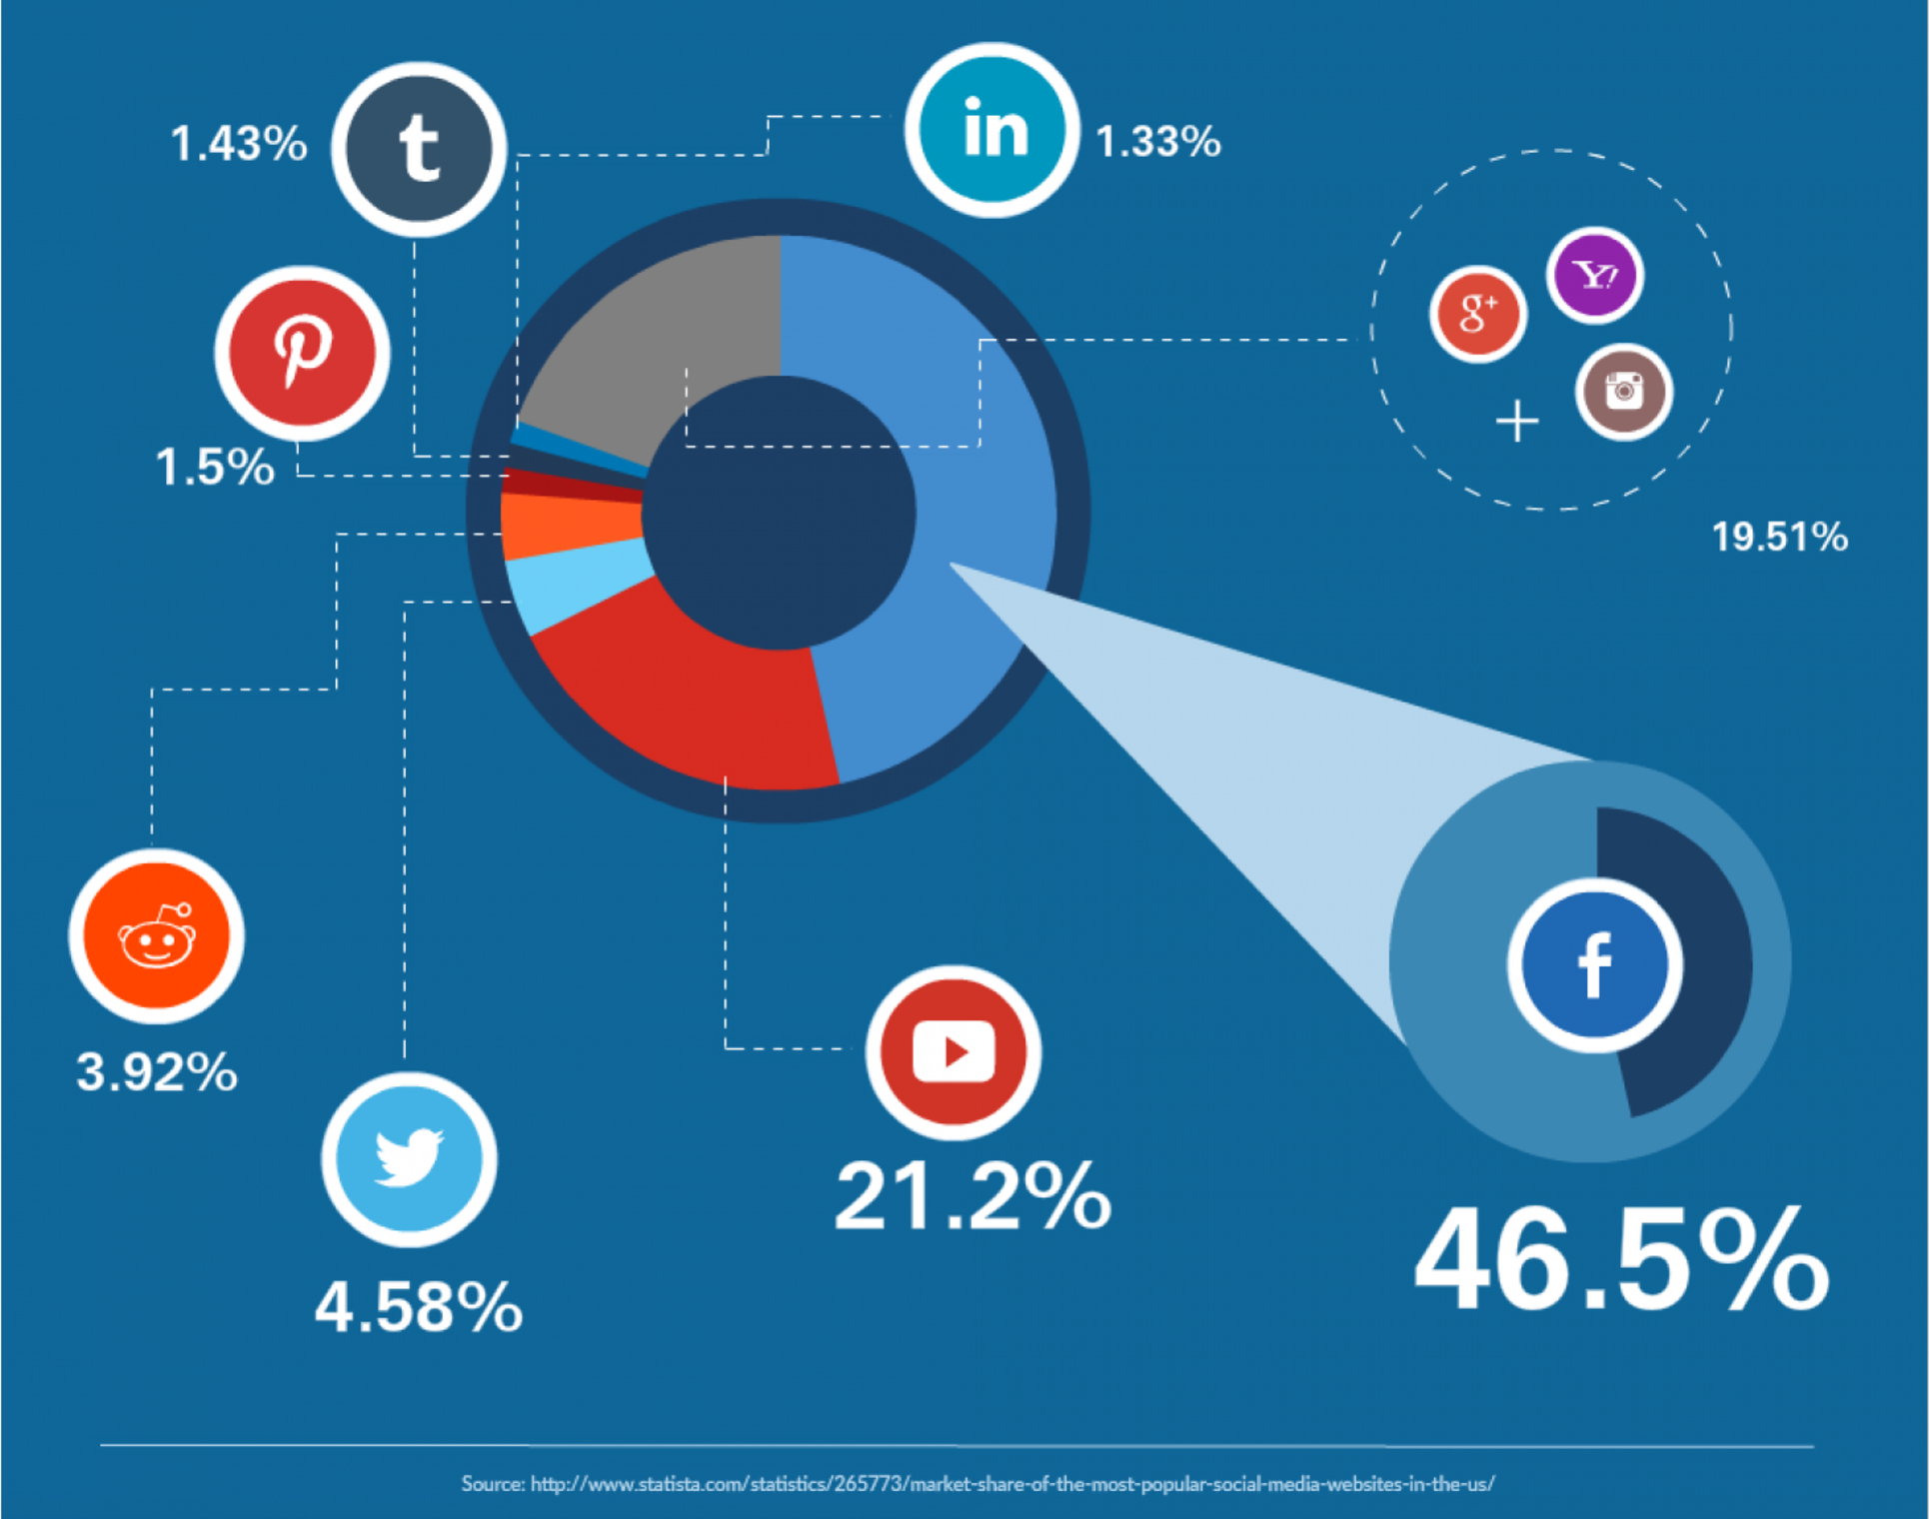
Notes:
Good visulizations can provide insights into what company competes with and identify unquie niches for services
Yes, Facebook owns a majority of the social media sector but are there niche markets within social media that others have a strong hold on?
Pinterest – Young Creative Women - http://capitalistcreations.com/how-pinterest-created-its-own-niche-market-from-facebook-users/

Slide 16
Strategy in what context?
People
What skills does the person need to make the right decision?
Process
What structure or system does an employee need to make the right decision ?
Incentives
What info and drivers need to be presented to influence ?

Slide 17
It is not the most intellectual of the species that survives; it is not the strongest that survives; but the species that survives is the one that is able to adapt to and to adjust best to the changing environment in which it finds itself……so says Charles Darwin in his “Origin of Species.”
Notes:
Speaking about the extinction of the Dodo Bird

Slide 18
Adapt to Adaptation
How do we adapt the organization to industry dynamics and redesign the organization to be more decision-centric ?
Never think of data as just numbers – they always have a human element

Slide 19
Stakeholders in a Data Science Project
Project Sponsor
Represents the business
Inherits and champions the project
Client
represents end users interests
Domain expert
Data Scientist
Sets and executes analytic strategy
Communicates with sponsor / client
Data Architect
Manages data & data storage
Sometimes manages data collection
Operations
Manages infrastructure
Deploys final product results
Notes:
How should they interpret the output ?
What does the model output and what are the inputs ?
What does the accuracy mean and what’s its impact ?
How should they interpret a confidence score?
What might potentially over rule the model? Can it be hacked?

Slide 20
Data Impact
Before sharing results with others in the organization one must approach the following:
How as the data collected
Is their any bias
What data did you remove and why?
What values are invalid and why?
What assumptions have I made

Slide 21
A Data Project guide
Different audiences require different kinds of information
Business oriented presentations
Want to understand the impacts of your findings in terms of business metrics
Technical oriented presentations
How to hand off and operationalize
Methods
Approaches
How-to-guides
Standard Operating Procedure
How will this model help them to their job better
Notes:
How should they interpret the output ?
What does the model output and what are the inputs ?
What does the accuracy mean and what’s its impact ?
How should they interpret a confidence score?
What might potentially over rule the model? Can it be hacked?

Slide 22
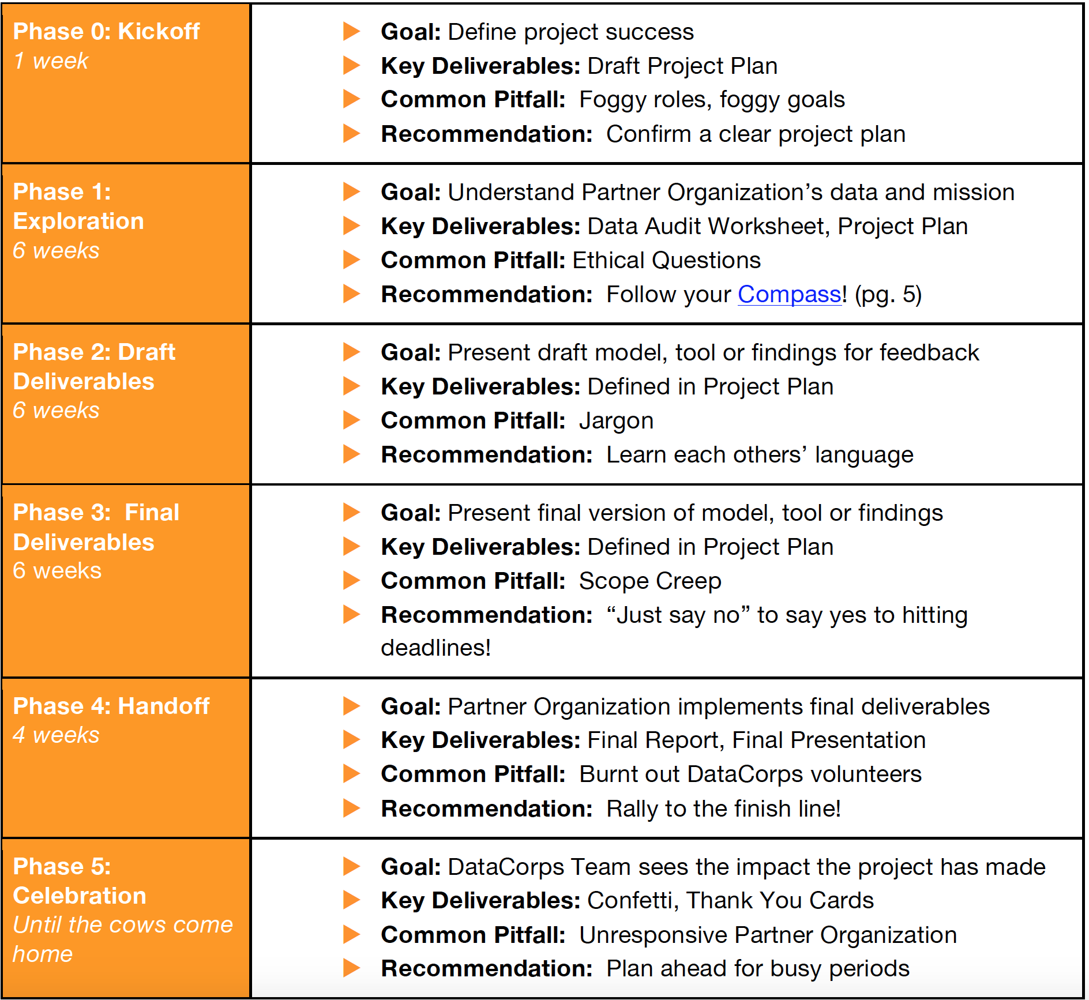

Slide 23
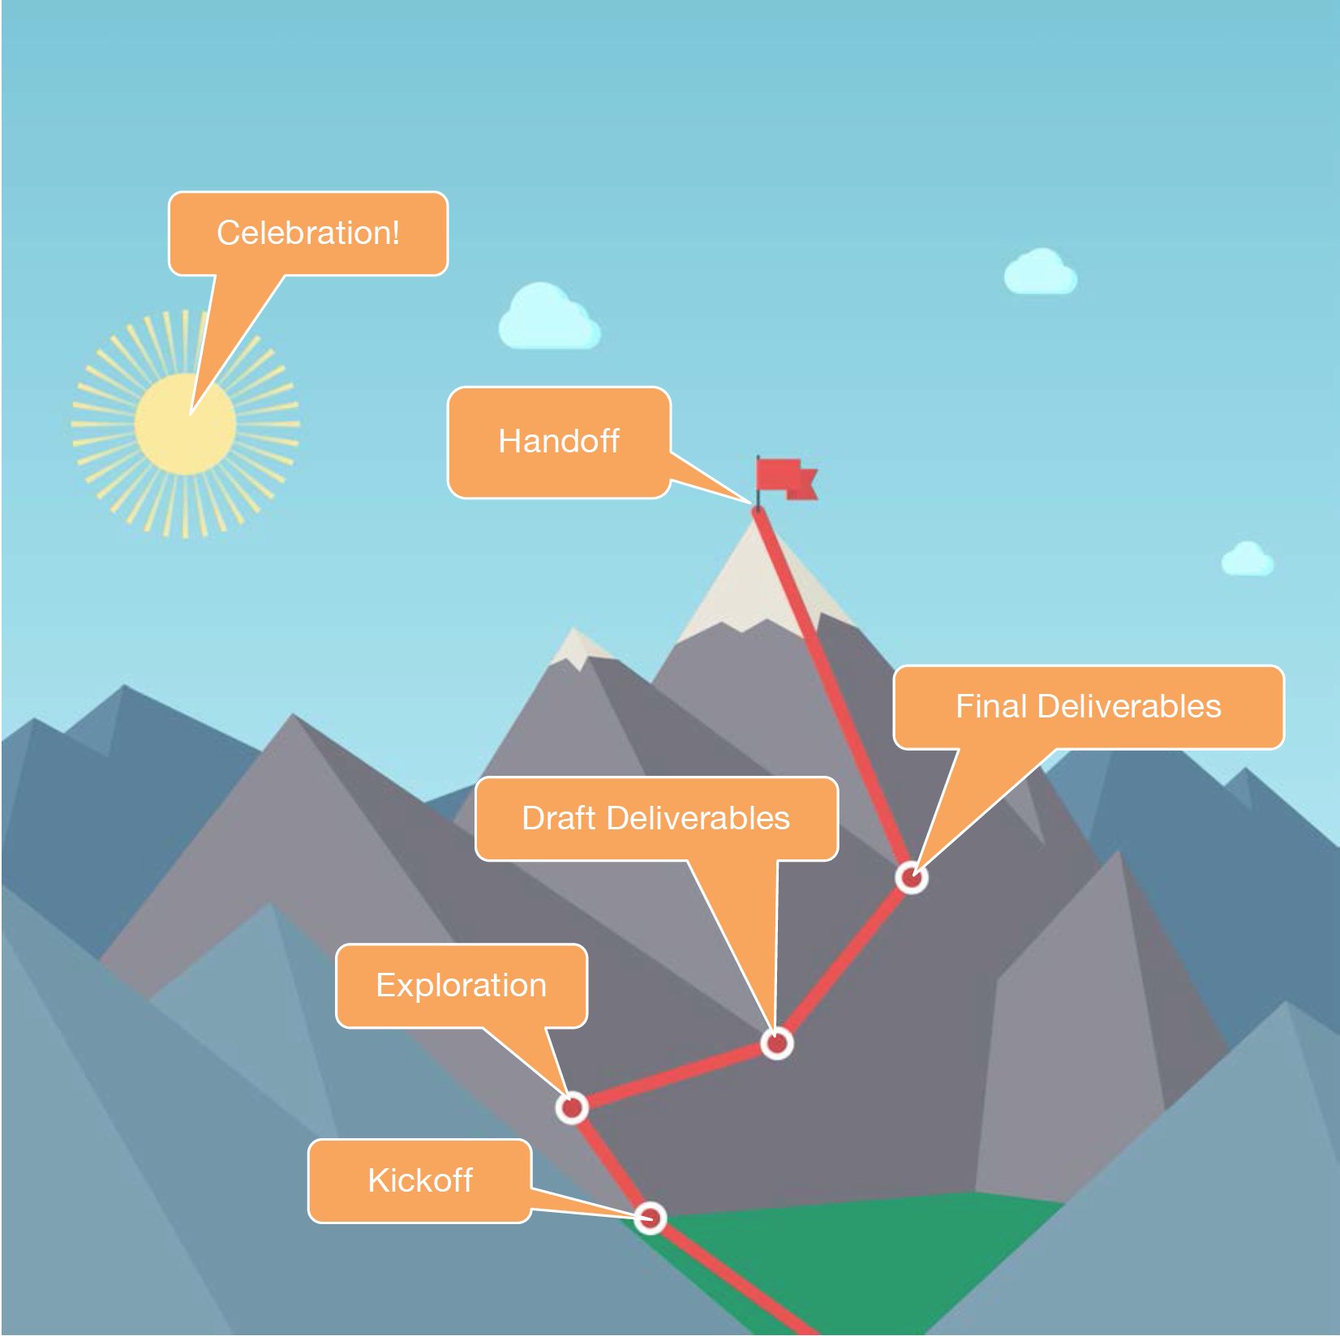

Slide 24
What else is there to improve?
When a project ends or if you get stuck you can always come back to the following:
Recruit new partners
Research more profitable business goals
Design new experiments
Specify new variables
Collect more data
Explore new visualizations
Design new presentations
Test old assumptions
Implement new methods
Try new tools
Take another NYC Data Science Academy Course ☺

Slide 25
Hands On Exercise
Big Box Store competitors

Slide 26
Home Depot vs Lowes
The HDLData is a compilation of a web scrapper to obtain recent Home Depot and Lowes stores across all 50 states. The store location data was merged with 2000 and 2010 Census data and identifies the demographics of the store locations.
While there are similarities in the stores of what they sell (home improvement merchandise) there is a unique strategy for each of the stores target market.

Slide 27
Home Depot vs Lowes
Data Dictionary
Areaname – city / town name
County – zipcode
State
Lcount – count of Lowes stores in the town/city
Hdcount – count of Home Depot in the town/city
Pop_2000 – population in 2000
Pop_2010 – population in 2010
Income_2000 – avg income in 2000
Income_2010 – avg income in 2010
pct_U18_2000 – percent under 18 in 2000
pct_U18_2010 – percent under 18 in 2010
Pct_college_2000 – percent in college per town in 2000
Pct_college_2010 – percent in college per town in 2010
Ownhome_2000 – percent owned home in 2000
Ownhome_2010 – percent owned home in 2010
Density_2000 – percent density per town in 2000
Density_2010 – percent density per town in 2010
Pct_white_2000 – percent of Caucasian in town in 2000
Pct_white_2010 – percent of Caucasian in town in 2010
Pct_black_2000 – percent African American in 2000
Pct_black_2010 – percent African American in 2010

Slide 28
Questions
How do these box stores make their decisions about where to locate their stores? Do they follow a certain criteria of demographics to choose their locations? How are the chains similar in their decision making ? How are they different?
What kind of customers are Lowes and Home Depot targeting?
What are the top 5 towns / cities that can be predicted as potential candidates for new locations for both Lowes and Home Depot?

Slide 29
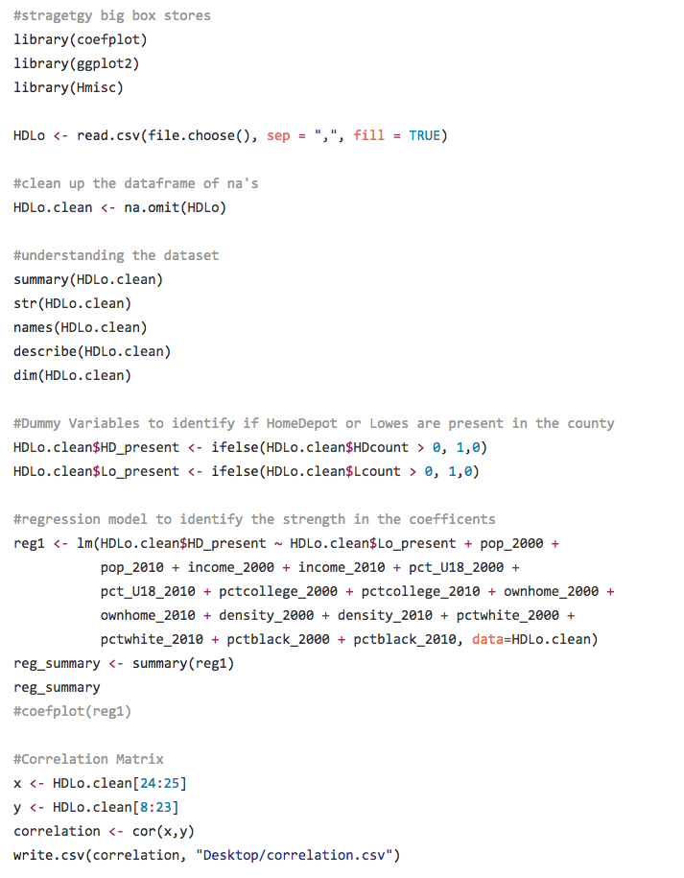

Slide 30
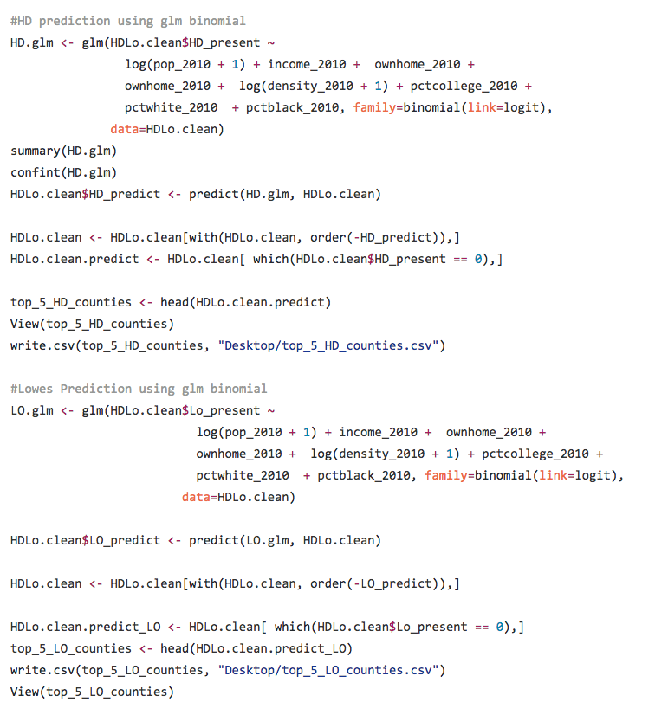

Slide 31
Blogs and the twitterverse <
Blog.rstudio.org
@hadleywickham
@Rstudiotips
R-bloggers.com
#rstats
@blodge8

